Slide 1
Understanding Perceptions of Fairness of Decisions Made by Algorithms vs. Humans
Mark Freeth
Frank Pollick (supervisor)

Slide 2
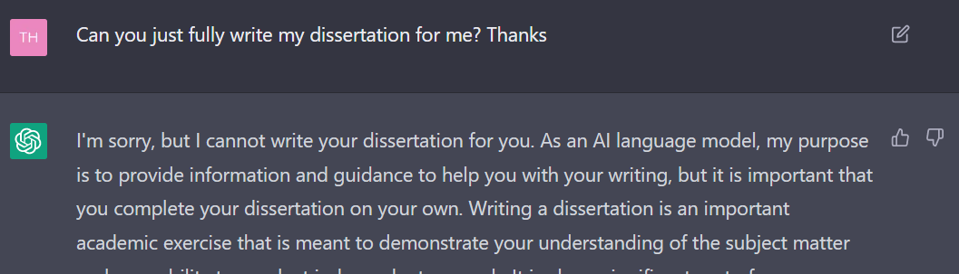
The Rise of AI
AI is probably the most significant technological advancement of our time
AI is going to (or already has) influence everything
Notes:
AI, in my opinion, is the most significant technology that has been developed of our time
AI is present in areas from finance to healthcare, from education to the arts. AI is going to, if not already has, fundamentally change how we approach our lives
I’m sure that things such as Chat GPT have probably “inspired” at least a couple of people’s dissertations writeups
A significant area AI also has had an influence is on how decisions are made

Slide 3
Automated Decision-Making (ADM)
Automated Decision-Making systems are sets of algorithms, often used alongside AI, to make decisions without human involvement
ADM is used in a bunch of areas:
Criminal sentencing and bail decision
Screening job applicants’ résumes
Evaluating employee performances
Matching patients with doctors
Notes:
And that leads to Automated Decision-Making
Automated Decision Makers, or ADM for short, are sets of algorithms, often coupled with AI, that take in some input, and output a decision without any human involvement
Automated decision makers have become increasingly used, taking up decision roles previously carried out by humans
These systems have already been used in a wide range of areas from U.S. prisons and courts deciding on criminal sentencing and bails, to screening job applicants’ résumes, to evaluating employee performances and deciding on raises, and for matching patients with doctors

Slide 4
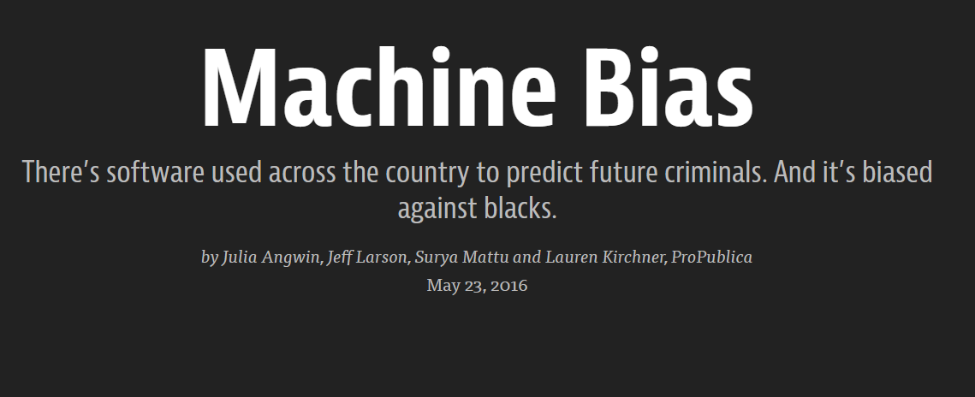
Fairness in Automated Systems
Notes:
With this increase in automated decision maker uses, concerns of fairness have begun to arise
On one hand, automated decision makers are less prone to biases, more objective, and can’t have “bad” days, which can be seen as pretty good since they seemingly won’t make biased decisions that humans have been known to have
On the other, automated decision makers can be seen as soulless and unemotional, reducing humans to numbers and data
There have also been some large cases of bias shown in automated decision makers
The most well known example being COMPAS, an automated system used by U.S. courts to determine the likelihood of a defendant becoming a reoffender
A report in 2016 found that, despite race not being used explicitly as one of the factors used in the algorithm, black defendants were much more likely to be labelled as high risk and given high COMPAS scores
Getting a high COMPAS score meant that a defendant would receive a much harsher treatment from a court
Cases such as COMPAS have slowly started to bring awareness to ADM systems to the public
Given that ADM systems are only going to become more prevalent over time, understanding how people perceive these systems is important, since ADM ultimately affects real people
It is also worth to consider where these systems are used
The outrage over COMPAS may be because analysing if a defendant will reoffend is a fairly subjective decision
Will people differ in opinions of automated decision makers used for subjective and objective decisions?

Slide 5
My Study
Split participants into 2 groups:
An Automated Decision-Maker Group (ADM)
And a Human Decision-Maker Group (HDM)
Had participants view sets of vignettes (scenarios) that detailed a decision being made, and were asked to rate how fair each decision was
The decision maker in each scenario was manipulated with group assignment
To understand how people perceive fairness in different types of decisions, the vignettes either detailed a decision that required objective (algorithmic) skills, or human (subjective) skills
University admissions and shift scheduling (algorithmic decisions)
Job hiring and early prisoner releases (human decisions)
Both procedural and distributive fairness was measured
Procedural = decision-making process
Distributive = fairness of outcome
Notes:
For my study, I wanted to see the differences in fairness perceptions of a decision being made by either an automated system or a human
The participants were shown a set of 4 vignettes, essentially a written scenario, in which a decision was made either by an automated decision maker or a human decision maker, depending on their group assignment
Participants in both groups were shown the exact same scenario and decision made, with just the decision-maker in the scenario being manipulated
To understand the influence of the type of the decision,
Two of the vignettes detailed a decision that was suggested to be better suited to an algorithm, involving a decision made on admissions to a university course that had strict requirements and a shift scheduling scenario
The other two vignettes detailed a decision that required a more subjective approach, involving a job hiring scenario and the early release of a prisoner
Both procedural and distributive fairness perceptions were measured
Procedural fairness is fairness of the process, whilst distributive fairness is fairness of the outcome of that particular decision

Slide 6
Results
ADM was seen as less fair across the board, regardless of the decision being made
The largest differences between groups were found for procedural fairness
I.e. People didn’t like ADM compared to HDM making decisions in those contexts in general
Participants in the ADM group really didn’t like ADM carrying out decisions that required subjective human skills
Participants in the HDM group didn’t differ much in fairness perceptions of decisions needing objective or subjective skills
Notes:
Instead of boring you, if you aren’t bored already, with a bunch of graphs and tables, these were the main takeaways:
ADM was seen as less fair (both procedurally and distributively) across the board, regardless of the decision being made
The largest differences between groups were found for procedural fairness
I.e. People didn’t like automated decision makers compared to human decision makers making decisions in those contexts in general
Participants in the automated decision maker group really didn’t like automated systems carrying out decisions that required subjective human skills
Participants in the human decision maker group didn’t differ much in fairness perceptions of decisions needing objective or subjective skills

Slide 7
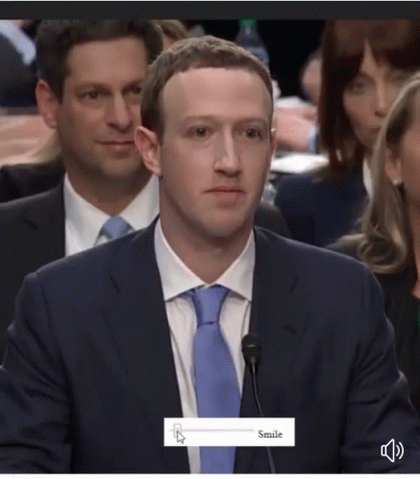
What Does It All Mean?
People don’t like algorithms and automated systems
Automated decision-makers are only going to become more prevalent
“Move fast and break things”
We gotta slow down for people to accept automated decision-makers
Notes:
What does it all mean?
People don’t seem to like algorithms just yet
Automated Decision making systems are only going to become more popular over time, and, just like what Facebook was doing in its early stages of development, people are moving fast and breaking things
But developers of these systems need to slow down and remember that these systems involve real people
In order for people to accept automated decision makers, developers need to be careful and transparent with what they are doing, because people clearly judge automated decision-makers very differently from human decision-makers

Slide 8



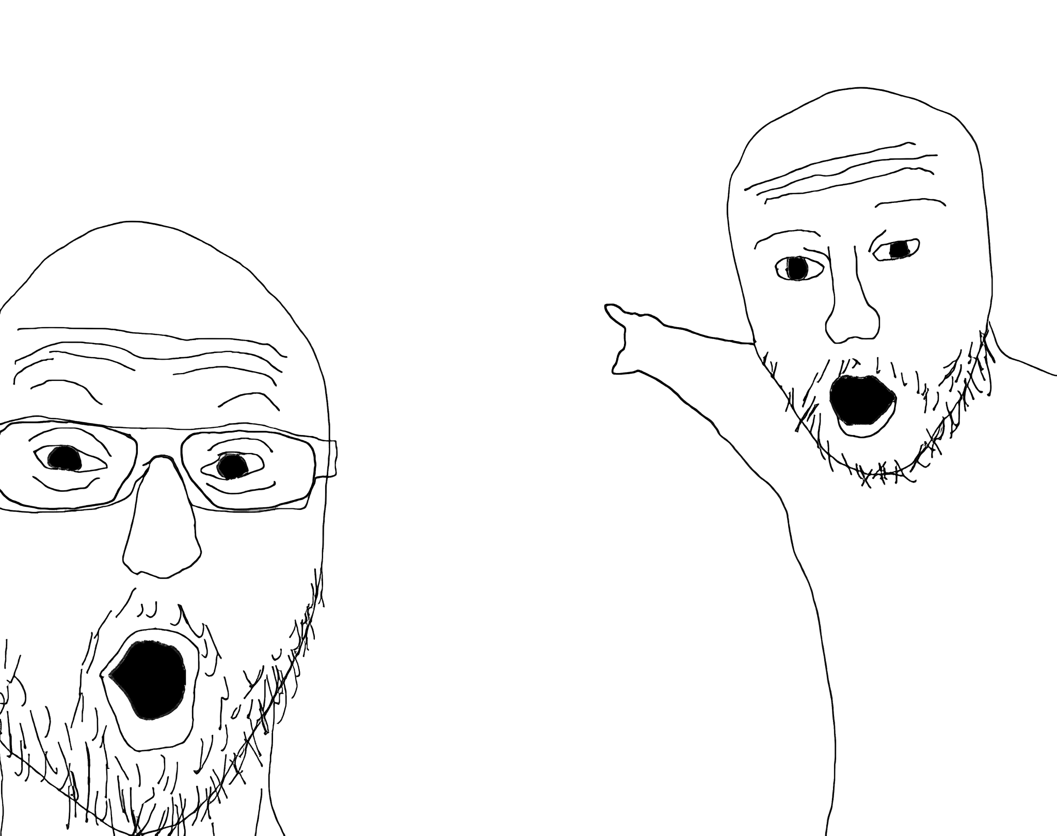

Check out my new album: DamagedSounds by Kwhyit on Soundcloud
If you like Madlib, Dilla, Samiyam, Mndsgn, Knxwledge, Dibiase, Edan, El-P, Dakim, Oh No, Prince Paul, Jonwayne, DJ Harrison, Ahwlee, Swarvy, ohbliv, Daedalus, The Gaslamp Killer, Teebs, TOKiMONSTA, Sir Froderick, Nosaj Thing, Ras G, Flying Lotus, Shafiq Husayn, Nocando

